Slide 1
Lammps Example Application
Twist, Slide, and Roll
Tatiana Flanagan and Leo Silbert
Presentation for Coffee into Coders
April 1st, 2026
Notes:
Today I’m going to walk through how we built a LAMMPS simulation that models granular particles, and specifically about sliding, rolling, and twisting interactions.

Slide 2
Agenda
Installation
Structure of our lammps script
Physics of simulation
Application demo
Notes:
I’ll start from installation, then explain how a LAMMPS script is structured, and the physics behind these effects, and finalize with a short demo

Slide 3
Instalation
Precompiled version with homebrew on a macs
  Step 1. Install homebrew
  /bin/bash -c "$(curl -fsSL https://raw.githubusercontent.com/Homebrew/install/HEAD/install.sh)”
  Step 2. Install lammps
  brew install lammps
  Step 3. Run script
  lmp_serial –in in.script
  or:
  lmp_serial < in.script > lmp.out
  (cleaner, faster, avoids log on screen)
Notes:
On macOS, the easiest way is using Homebrew.
Once installed, you run simulations directly from the terminal using an input file.
In my case, I used files like in.pour.setting.
However, if you want to handle lammps directly from python, try installing with conda
You can also compile lammps. This will give you access to tools that are not available in the precompiled version – like movies.

Slide 4
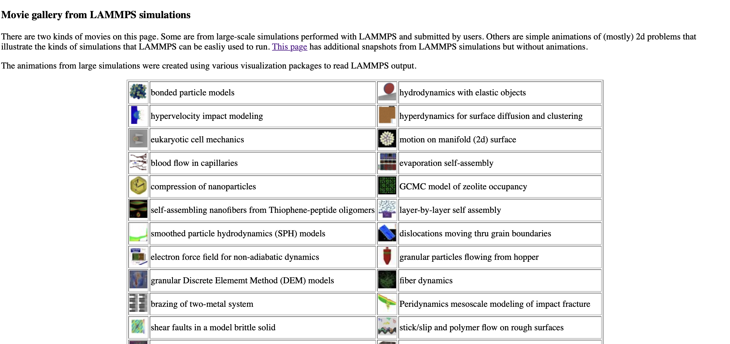
Best way to start
Running examples
  Many examples in lammps installation and lammps website: https://www.lammps.org/movies.html
  Documentation: https://docs.lammps.org/Examples.html

Slide 5
What helps with learning?
What helped me with learning?
  Debugging with google/ai
    Put your error in google, it will tell you the most likely cause and solution
  lammps web pages
    Describe parameters and functions

Slide 6
Input syntax
LAMMPS is driven entirely by a text script.
LAMMPS runs the script line by line, in strict order.
Building Blocks of a LAMMPS Script. Every script has these core parts:
  Initialization
  System definition
  Interaction physics
  Fixes (motion & forces) - evolution
  Output
  Run
Notes:
LAMMPS is not a point-and-click program. Everything is controlled through a script.
That script defines the particles, the forces, the environment, and how the system evolves in time
Every LAMMPS simulation follows this structure.
You can think of it as building a world, defining the laws of physics, then letting it evolve.

Slide 7
Script
Structure
(example)
Initializes the physical
environment and fundamental
properties of your particles.
ppfm – xyz boundaries
    # Initialization
    units si
    atom_style sphere
    boundary p p fm
    # System
    region box block 0 20 0 20 0 60
    create_box 1 box
    # Physics
    pair_style granular ...
    # Motion
    fix 1 all nve/sphere
    fix 2 all gravity ...
    # Output
    dump 1 all custom ...
    # Run
    run 100000
Defines the physical space
where your simulation will
take place
Contact mechanics
engine that defines how your
spheres interact
Physics of how your
particles move
over time. Evolution
This is a simplified version of the
structure of my script
Records
simulation
data
Execute 100 000 time steps
Notes:
Boundary p p fm
x-dimension: p (Periodic) - Particles interact across the boundary and can pass from one side to the other.
y-dimension: p (Periodic) - Same as x, particles can pass through the boundary.
z-dimension: fm (Non-periodic, Fixed Low, Shrink-Wrapped High) - This is a combined setting for the lower and upper z-faces.
f (Lower z-face): Fixed boundary. The simulation box boundary does not move, and particles that move outside the boundary may be "lost".
m (Upper z-face): Shrink-wrapped, but with a minimum value. The box boundary adjusts to encompass all particles, but will not shrink smaller than a minimum value set in the data file or create_box command
region box block 0 20 0 20 0 60: define a 3D rectangular simulation domain and initialize it for the simulation.
#Motion This LAMMPS command pair simulates the physical movement of finite-size spheres under gravity in an NVE (microcanonical) ensemble. It
updates positions, velocities, and angular velocities of all particles (nve/sphere) while applying a consistent gravitational force (gravity) to them
NVE:
N: Constant number of particles (moles).
V: Constant volume.
E: Constant total energy
NVE: This stands for constant Number of atoms, Volume, and Energy. It’s a "natural" movement where particles move based on the forces acting on them without an artificial heater or cooler (thermostat).
sphere: This is the crucial part. Because you are using atom_style sphere, your particles have a physical size. This fix doesn't just move them forward; it also calculates their rotation (angular momentum) based on the torques created when they rub against each other.
2. fix 2 all gravity (The Force)
This adds a constant downward acceleration to every particle.
Acts as the "motor" that gets things moving.
Without this, if your particles were just floating in the box, they would only move if you gave them an initial velocity. With this fix, they will accelerate (fall) until they hit the bottom or each other.

Slide 8
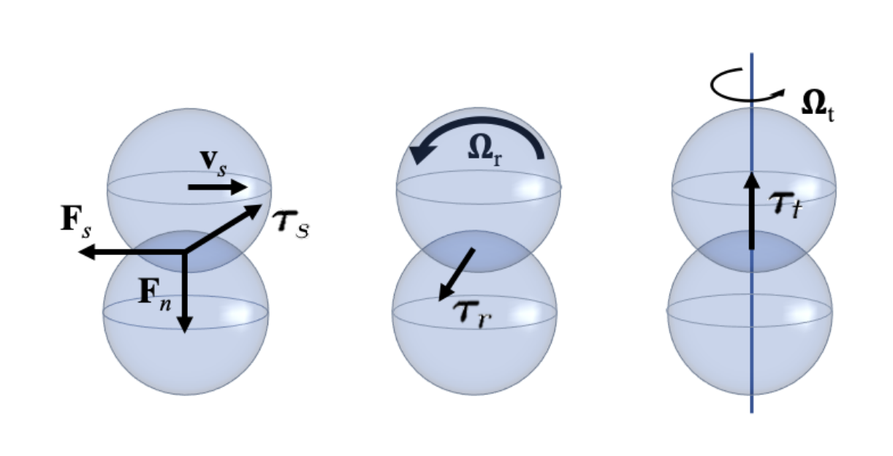
Granular contact physics
At every particle contact:
Fn Normal force → compression
Fs Tangential/sliding force → sliding friction
𝝉_{s} Sliding torque → resists sliding
𝝉_{r} Rolling torque → resists rolling
𝝉_{t} Twisting torque→ resists spin
Total interaction = force + torque contributions
Schematic of the granular particle interaction model
(Santos et al., 2020)
Santos, Andrew Pablo, et al. "Granular packings with sliding, rolling, and twisting friction." Physical Review E 102.3 (2020): 032903.
Notes:
Unlike simple models, granular interactions include not just forces but also torques.

Slide 9
Sliding, Rolling, and Twisting
Sliding: Force of friction.
Point of contact has a velocity.
  Tangential motion at contact
  Controls slipping
Rolling. Torque of resistance. Normal force shifts and creates a rolling torque.
  Rotation across surfaces
  Adds torque resistance to angular velocity
Twisting. Pivot torque.
Ball rotates around axis of contact
  Spin about contact axis
  Adds rotational damping
Schematic of the granular particle interaction model
(Santos et al., 2020)
Santos, Andrew Pablo, et al. "Granular packings with sliding, rolling, and twisting friction." Physical Review E 102.3 (2020): 032903.
Notes:
Sliding is what we usually think of as friction.
Rolling is when particles rotate over each other instead of sliding.
Twisting is rotation around the contact normal — like spinning in place.
My script includes all three.

Slide 10
Example application
Spheres pouring and settling with rolling and twisting
  Basic physics implementation
  Demo

Slide 11
Thank you

Slide 12
Additional Information

Slide 13
Extracting information
1. Dump files (raw simulation data)
The dump command tells LAMMPS what data to save, how often, and in what format during a simulation.
dump ID group-ID style N file attributes
Example: dump 3 all custom 100 dump.lammpstrj id type radius x y z vx vy vz omegax omegay omegaz fx fy fz tqx tqy tqz.
Common attributes
  Position and motion
x y z # position
vx vy vz # velocity
  Rotation
omegax omegay omegaz # angular velocity
  Forces
    fx fy fz
  Torques
    tx ty tz
  Particle size
    Radius

Slide 14
Visualization:
- LAMMPS dump files (.lammpstrj) are directly readable in OVITO
OVITO uses:
positions → particle motion
radius → particle size
can visualize velocity, force, etc.
To make a mpeg movie with png files you can use ffmpeg.
For example:
ffmpeg -y -framerate 20 -pattern_type glob -i 'image.*.png' -vf "pad=ceil(iw/2)*2:ceil(ih/2)*2" -c:v libx264
-pix_fmt yuv420p pouring_demo_twisting.mp4

Slide 15
3. Visualization and Data Analysis
Option A: Visualization to inspect motion, structure, rotations
  Open in OVITO
  Make mpeg movie -example
  Make a movie in lammps – needs compiled version
Option B: Data analysis (Python, Matlab)
Load as text or dataframe
Example workflow:
  Parse timesteps
  Extract particle properties
  Analyze forces, contacts, structure

